Slide 1
SoftHier Project Closure Report – PULP Team Side
Chi Zhang chizhang@iis.ee.ethz.ch
Luca Colagrande colluca@iis.ee.ethz.ch
Thomas Benz tbenz@iis.ee.ethz.ch
Prof. Luca Benini lbenini@iis.ee.ethz.ch

Slide 2
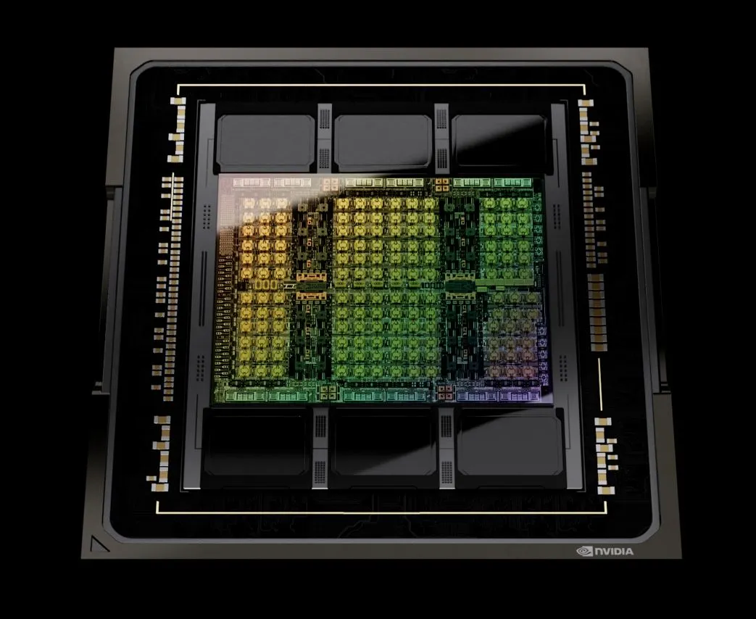
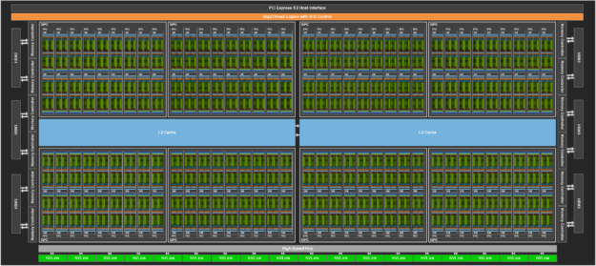



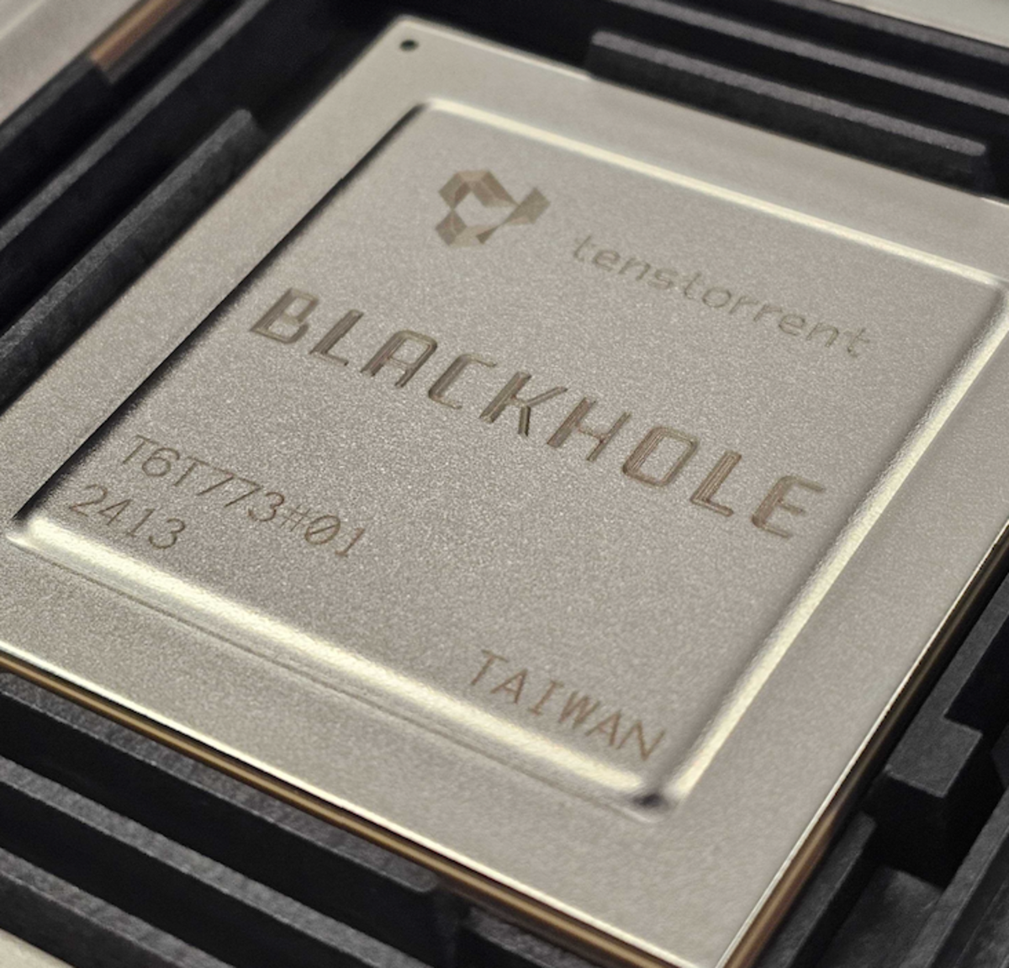
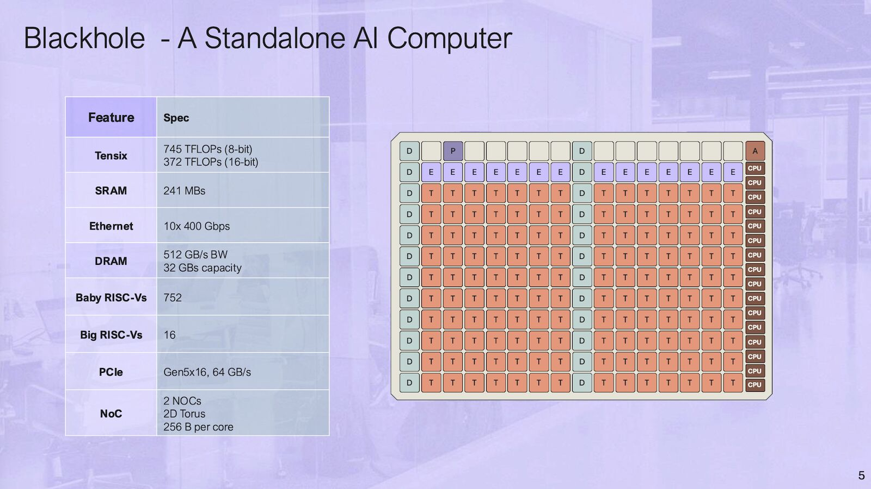


Introduction to SoftHier Project
End of Dennard Scaling
Leads to "power wall" across computing systems, from mobile to supercomputers.
Hardware-software codesign critical to improving performance under tight power constraints.
Shift to Massively Parallel Architectures
Scaling to thousands of Processing Elements (PEs) essential for power-efficient performance.
Embarrassingly parallel workloads (e.g., Large Language Models) driving the need for KiloPE architectures.

Slide 3
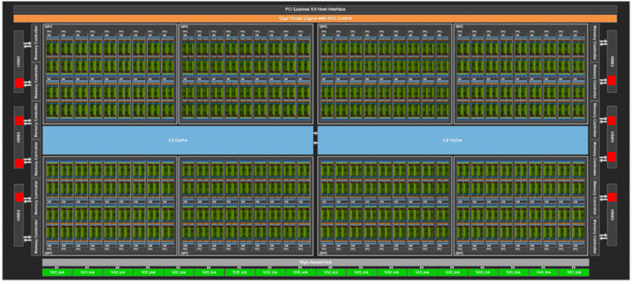
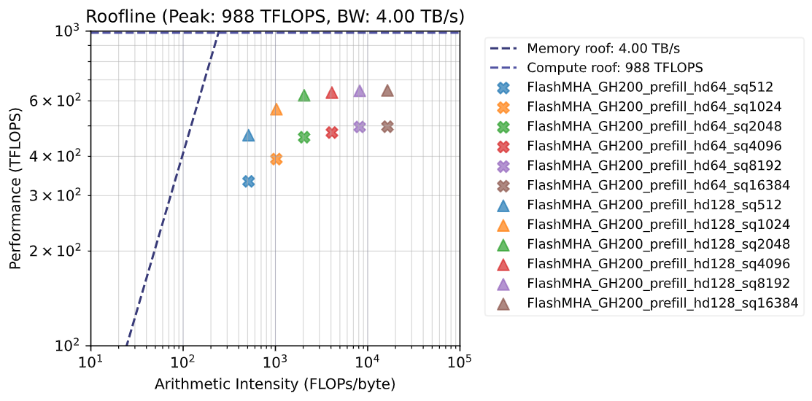
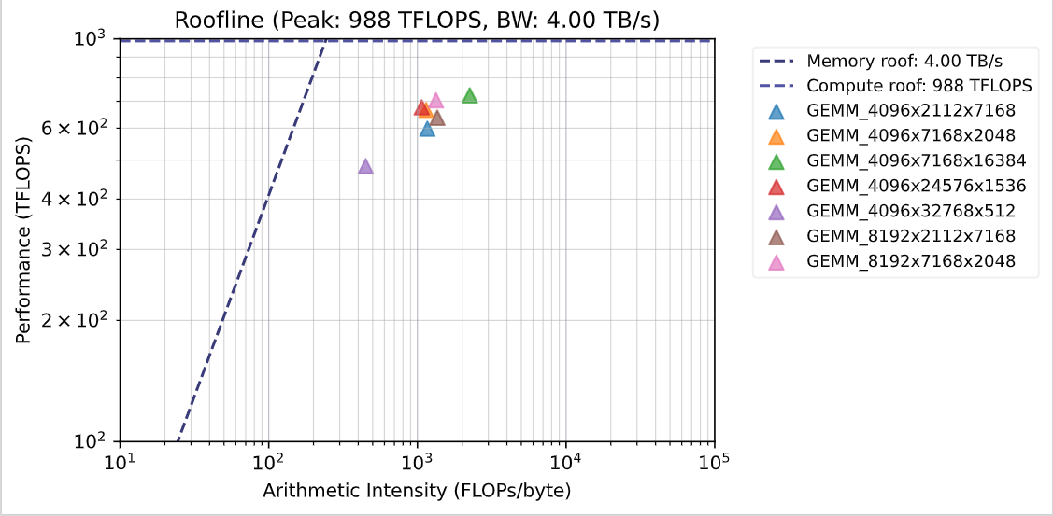
Introduction to SoftHier Project
Core Challenges in Memory Hierarchy
Instruction Memory Bottlenecks
Demand for domain-specific ISAs to efficiently manage thousands of operations with single instructions.
Amortizing instruction fetches reduces energy impact on the instruction memory.
Data Memory Bottlenecks (The "Memory Wall")
High-bandwidth demands from PEs challenge traditional memory architectures.
Scaling KiloPEs requires novel solutions beyond classical cache hierarchies.
64%
Perf Gap
36%
55%
Gap
28%
FP16 FlashAttn on GH200
FP16 GEMM on GH200
GH200

Slide 4


SoftHier Project Objective
The objective of SoftHier is to drastically reduce hardware inefficiency by replacing caches with software-managed, efficient SPMs and DMAs, while maintaining programming effort low for the application developer
This goal will be achieved thanks to
An increased level of automation in the programming tool flow
The use of domain-specific languages and abstractions.
Hardware enhancements in the memory hierarchy that facilitate automatic instantiation of accelerated data-motion primitives from abstract, streamlined software APIs.
Work Package for PULP team
Aims at architecture exploration, sizing and design of advanced functions related to data motion subsystems (SPM, DMA, NoC, memory controllers) to assess their hardware cost and to analyze the efficiency of the new architecture on the targeted applications
Our PULP Group
Prof. Torsten Hoefler’s Group

Slide 5
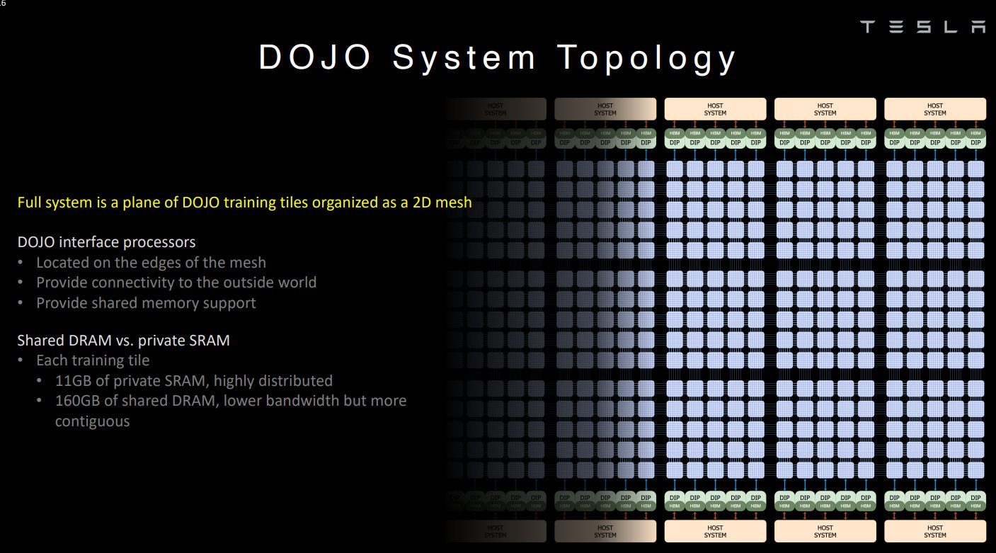
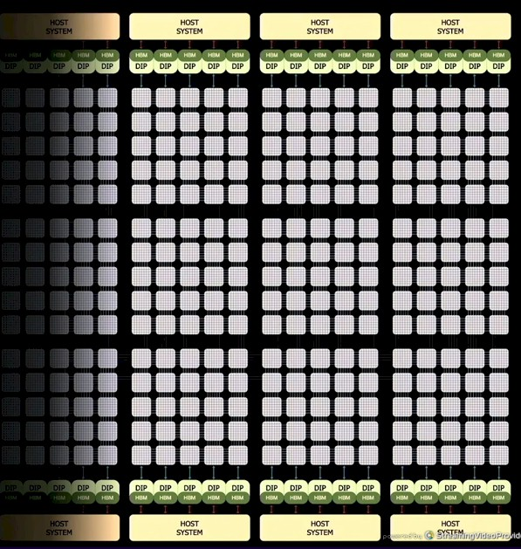
Template Architecture Overview Tile-Based Many-PE
Tile-based many-PE accelerators
Structured as meshes of compute tiles
Matrix, vector and scalar engines
Local explicitly managed memories
Interconnect with scalable NoC topology
Main memory positioned at die boundaries
Favors silicon efficiency and scalability
A dense compute tile placement
Software-controlled partitioned memory hierarchy
Eliminates L2 on-chip cache for area efficiency
Examples
Tesla’s Dojo, Tenstorrent’s Blackhole
Matrix engine
L1 local memory
Vector engine
I$
interconnect
Scalar core
DMA
To Router
CH0
CH1
…
CHn
HBM CTRL
Tile
Tile
Tile
Tile
R
R
R
R
Tile
Tile
Tile
Tile
R
R
R
R
CH0
CH1
…
CHn
HBM CTRL
HBM CTRL
Tile
Tile
Tile
Tile
CH0
CH1
…
CHn
R
R
R
R
Tile
Tile
Tile
Tile
R
R
R
R
HBM CTRL
CH0
CH1
…
CHn
Tile-Based Many-PE
vs Nvidia GPU Arch
HBM CTRL
HBM CTRL
HBM CTRL
SM
SM
L2 Cache
SM
SM
L1
L1
L1
L1
SM
SM
SM
SM
L1
L1
L1
L1
SM
SM
SM
SM
L1
L1
L1
L1
SM
SM
SM
SM
L1
L1
L1
L1
HBM CTRL
HBM CTRL
HBM CTRL

Slide 6

High-Level Simulation Model – SoftHier System
Fully Parameterizable through Configuration File
System configuration
#Tiles (#row, #column)
NoC link data width
#HBM channels and placement on 4 edges
Cluster configuration
L1 memory capacity and bandwidth
Matrix engine systolic array (shape, CE pipeline stage)
DMA burst length, #outstanding burst
Based on GVSoC^{[1]} Platform
Event-based simulator, fast simulation speed up to 25 MIPS
Calibrated with RTL Models
To SYNC NoC Router
To DATA NoC Router
HBM
I $
Vector
Engine
Core 0
Matrix
Engine
DMA
R
R
R
R
Core 0
T
T
T
T
…
Core n
T
T
T
T
Interconnect
R
R
R
R
L1 local memory
HBM
HBM
T
T
T
T
R
R
R
R
TE Cluster
T
T
T
T
R
R
R
R
Data NoC Router
R
R
HBM
Sync NoC Router
https://github.com/gvsoc/gvsoc/tree/soft_hier_release

Slide 7
Review of Work Package – PULP Team Side
Define Baseline Template Architecture (M1-WP1)
Develop a High-Level Simulation Model (M1-WP1)
PPA Estimation (M2-WP1)
Specification and Preliminary Modelling and Analysis of Optimized Architecture (M3-WP1)
Based on the insight gathered in the first year of work, the memory hierarchy components will be tuned and optimized to facilitate programming and boost performance. The proposed hardware enhancements will be prototyped and their cost performance benefits will be assessed with microkernels.
Performance and Energy Estimation and Benchmarking (M4-WP1-WP2)
Benchmarking report on hardware-software integration between the two WPs, demonstrating targeted transformations to optimize and streamline performance for CLOUDSC cloud microphysics scheme and the LULESH hydrodynamics solver as well as ML applications. Detailed performance study with different application configurations and comparing various workflow options. For Ascend, we will aim at mapping deep-Learning kernels such as Transformer Decoders. (Report & Open-source release)
1st Year
2nd Year

Slide 8
Review of Work Package – PULP Team Side
For the 2nd Year, We have done
Proposed Architectural Optimization (M3-WP1):
Lightweight high-throughput collective capable NoC
RTL prototyping
Dataflow and NoC collective primitives co-design for key LLM kernels (M4-WP1-WP2)
FlatAttention for MHA and variants for GQA, MQA, DeepSeek MLA
End-to-End Performance Analysis for DeepSeekV3 Inference (M4-WP1-WP2)

Slide 9
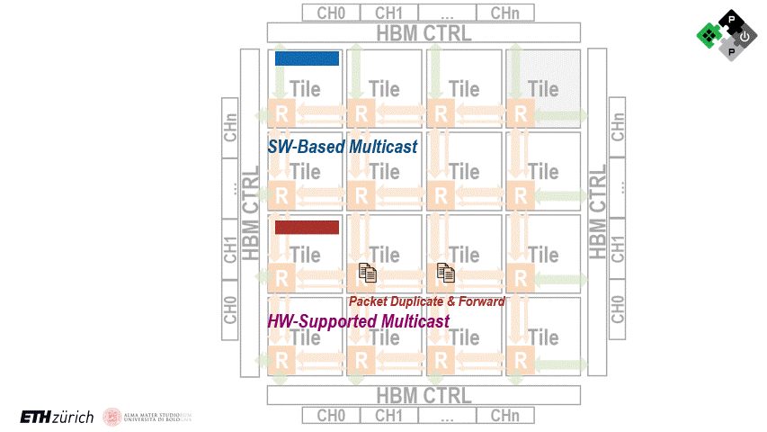
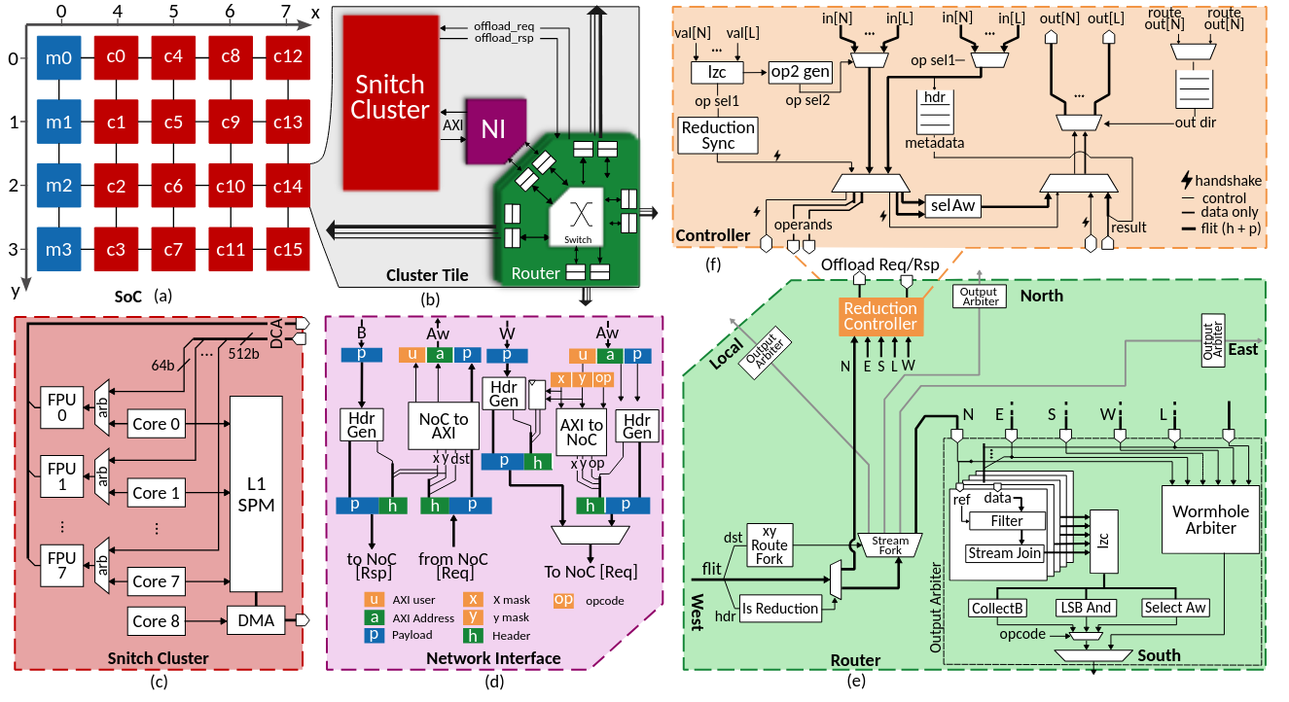
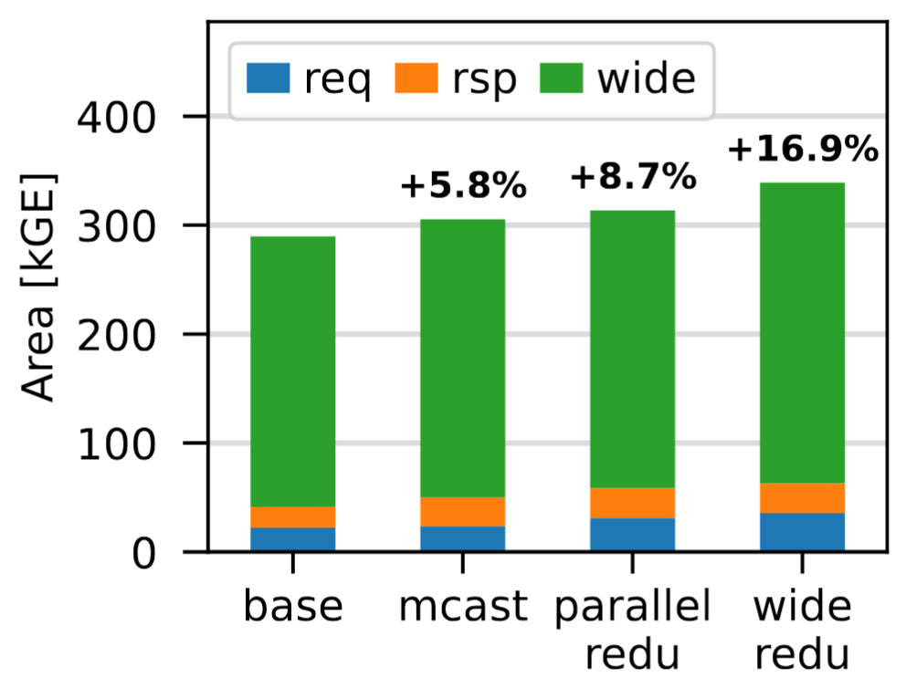
M3-WP1: Lightweight High-Throughput Collective Capable NoC
RTL Extension on NoC
Multicast + Reduction support on NoC router
Use FPUs inside tile for reduction operations
Model in GVSoC for SoftHier
Calibration with RTL, Average Runtime cycle deviation is around 16%
RTL Area analysis
Multicast adds 5.8% area overhead on router
Full Multicast + Reduction adds 16.9% area
Calibration
Area Overhead
NoC Extension in RTL

Slide 10
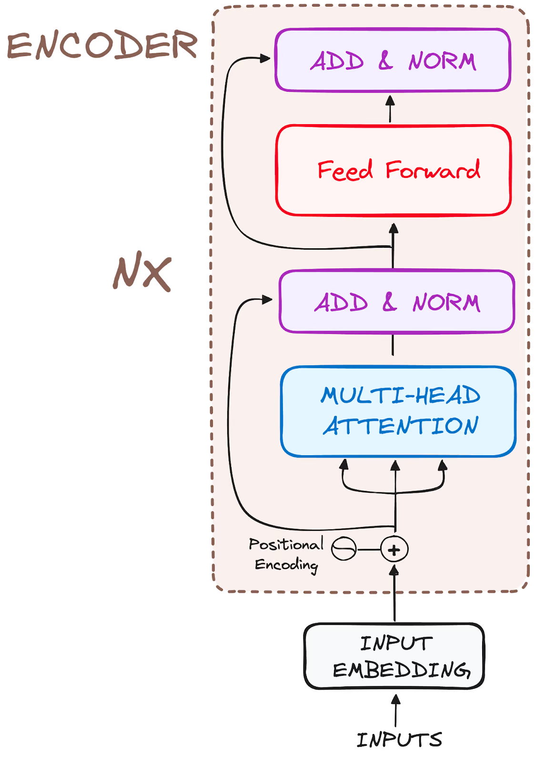
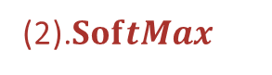
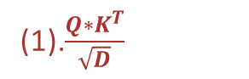

M4-WP1-WP2: The Attention Bottleneck in Transformer LLMs
LLM workloads have become increasingly impactful
DeepSeek-V3, ChatGPT, Llama
Dominating LLM are Transformer-based
The attention bottleneck
Multi-Head Attention (MHA) exhibits quadratic complexity over sequence length. O(S²)
Most operations in MHA are bottlenecked by memory accesses^{[2]}
Performance bottleneck for
LLM training
LLM inference
long context prefill and decode
D
K^{T}
S
Q
Attention Score
(1).$\frac{Q∗K^{T}}{\sqrt{D}}$
S
(2).$SoftMax$
O
SoftMax(Att.Score)
V
S
(3).$S∗V$
Multi Heads

Slide 11
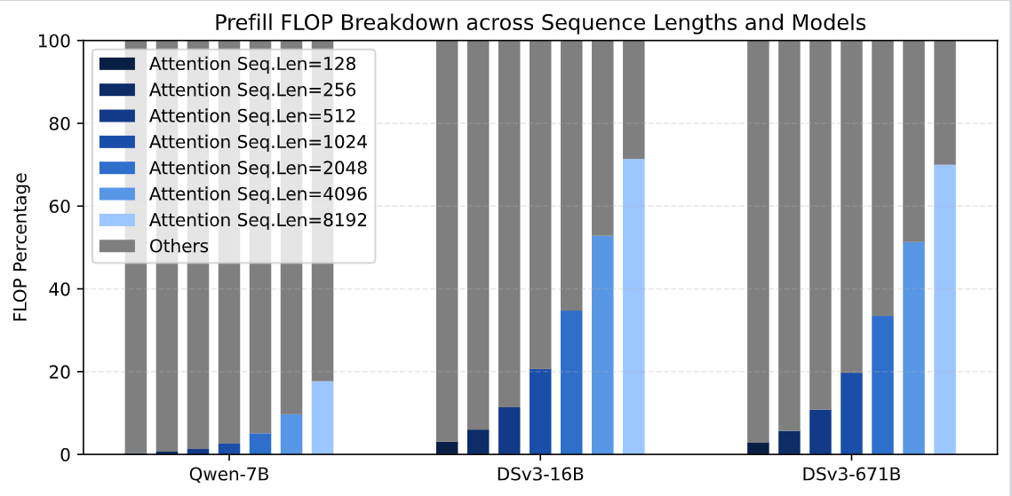
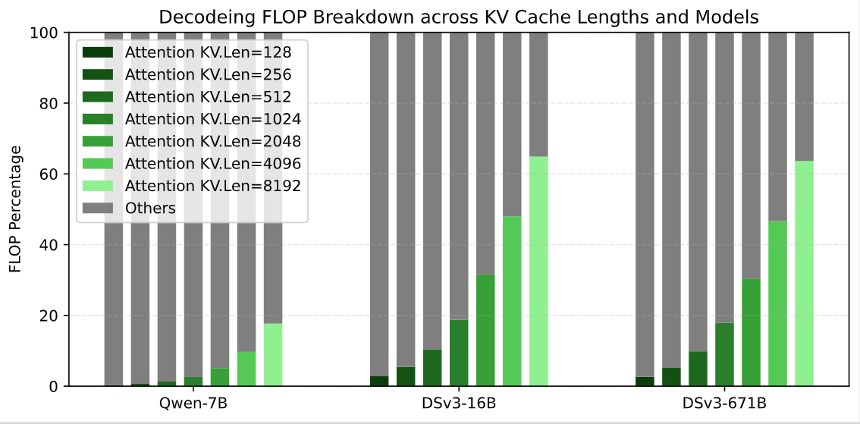
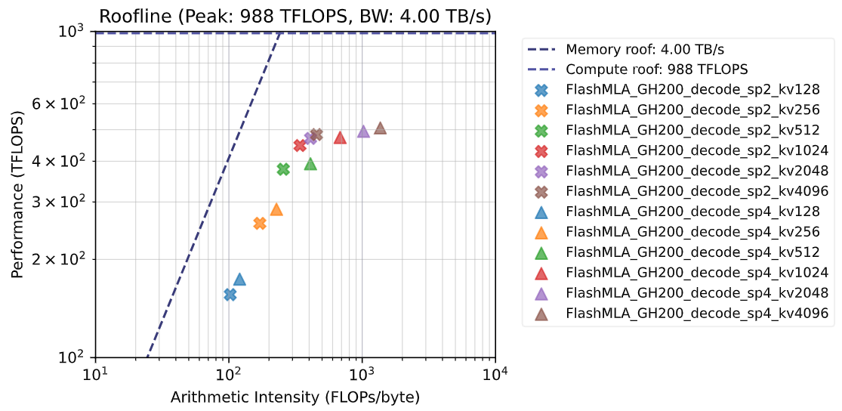
M4-WP1-WP2: The Attention Bottleneck in Transformer LLMs
With LLM model architecture evolution, Attention is becoming dominated
MHA + MLP in llama, qwen → MLA + MoE in DeepSeek, Kimi-v2
Attention kernels are not performing good enough on commercial GPUs in both prefill and decode stage
Optimized implementation for GPU: FlashAttention^{[3]} by Tri Dao, FlashMLA^{[4]} by DeepSeek team
Gap
MLA + MoE
MLA + MoE
Model FLOP Breakdown - Prefill
MHA + MLP
Prefill FlashAttn on GH200
Gap
MLA + MoE
MLA + MoE
Model FLOP Breakdown - Decode
MHA + MLP
Decode FlashMLA on GH200

Slide 12
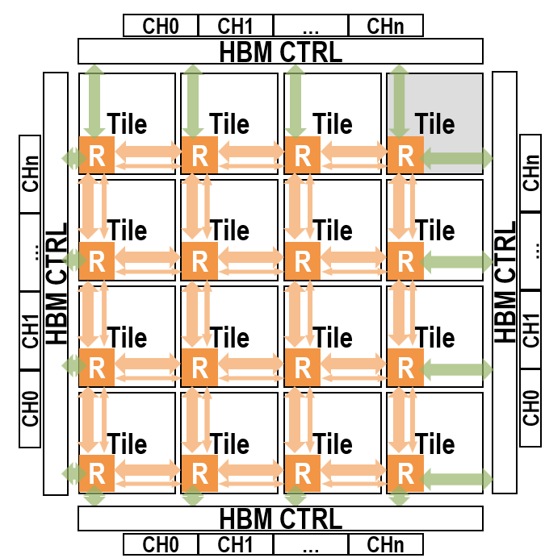
M4-WP1-WP2: Dataflow and NoC Collective Primitives Co-Design
We are targeting attention kernels on tile-based many-PE architecture. The goal is:
Achieve high utilization of the tiles’ matrix engines
Minimize energy-hungry off-chip accesses
Architecture and dataflow need to be co-explored
Dataflow leverages HW feature, e.g., collective primitives on NoC fabric

Slide 13
M4-WP1-WP2: Dataflow and NoC Collective Primitives Co-Design
We are targeting attention kernels on tile-based many-PE architecture. The goal is:
Achieve high utilization of the tiles’ matrix engines
Minimize energy-hungry off-chip accesses
Architecture and dataflow need to be co-explored
Dataflow leverages HW feature, e.g., collective primitives on NoC fabric
Accelerate inter-tile collective communications
Demonstrate attention workloads can be mapped more efficiently on tile-based architectures by leveraging collective communications on NoC

Slide 14
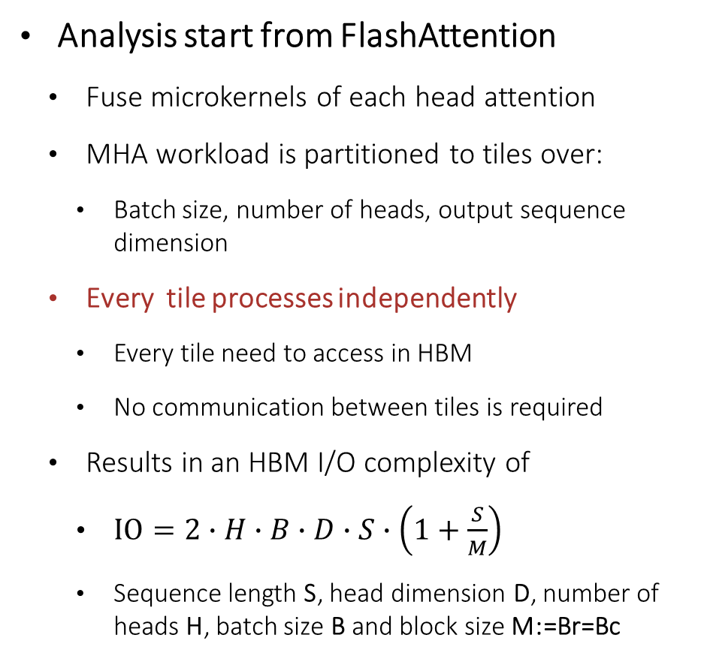
Inner Loop
M4-WP1-WP2: FlatAttention Motivation
K^{T}: d x S
Copy Block to SRAM
Analysis start from FlashAttention
Fuse microkernels of each head attention
MHA workload is partitioned to tiles over:
Batch size, number of heads, output sequence dimension
Every tile processes independently
Every tile need to access in HBM
No communication between tiles is required
Results in an HBM I/O complexity of
$IO=2∙H∙B∙D∙S∙\left(1+\frac{S}{M}\right)$
Sequence length S, head dimension D, number of heads H, batch size B and block size M:=Br=Bc
d x B_{c}
Q: S x d
V: S x d
Copy
B_{r} x d
B_{c} x d
Outer Loop
B_{r} x B_{c}
Copy
Inner Loop
Output to HBM
sm(QK^{T})V: S x d
Outer Loop
Tile
Tile
Tile
Tile
Tile
Tile
Tile
Tile
Tile
Tile
Tile
Tile
Tile
Tile
Tile
Tile

Slide 15
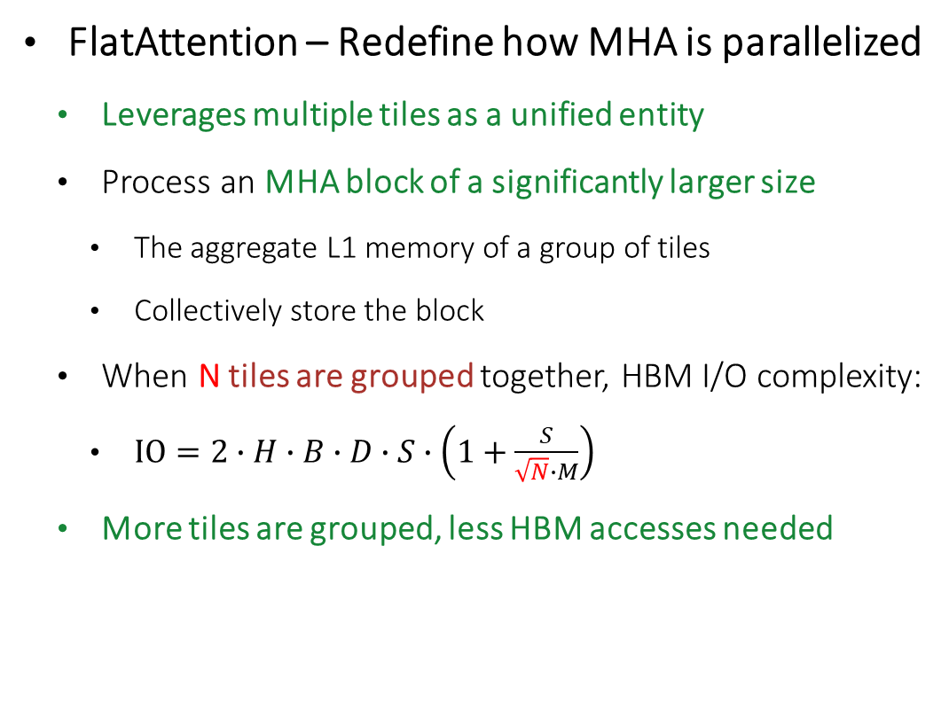
Inner Loop
M4-WP1-WP2: FlatAttention Motivation
K^{T}: d x S
Copy Block to SRAM
FlatAttention – Redefine how MHA is parallelized
Leverages multiple tiles as a unified entity
Process an MHA block of a significantly larger size
The aggregate L1 memory of a group of tiles
Collectively store the block
When N tiles are grouped together, HBM I/O complexity:
$IO=2∙H∙B∙D∙S∙\left(1+\frac{S}{\sqrt{N}∙M}\right)$
More tiles are grouped, less HBM accesses needed
d x B_{c}
Copy
Q: S x d
V: S x d
B_{r} x d
B_{c} x d
Outer Loop
B_{r} x B_{c}
Copy
Inner Loop
Output to HBM
sm(QK^{T})V: S x d
Outer Loop
Tile
Tile
Tile
Tile
Tile
Tile
Tile
Tile
Tile
Tile
Tile
Tile
Tile
Tile
Tile
Tile

Slide 16
M4-WP1-WP2: Detailed FlatAttention Dataflow
Distinct data movement patterns within the tile group
Edge tiles collect data from HBM once and inter-tile data exchange via collective communications
Tile
Tile
Tile
Tile
1
2
3
4
O
Q
V
O
Q
V
O
Q
V
O
Q
V
O
Q
V
O
Q
V
O
Q
V
O
Q
V
K^{T}
K^{T}
K^{T}
K^{T}
K^{T}
K^{T}
K^{T}
K^{T}
Tile
Tile
Tile
Tile
Att
Att
Att
Att
S
S
S
S
m l e l₋₁ m₋₁
m l e l₋₁ m₋₁
m l e l₋₁ m₋₁
m l e l₋₁ m₋₁
m l e l₋₁ m₋₁
m l e l₋₁ m₋₁
m l e l₋₁ m₋₁
m l e l₋₁ m₋₁
m l e l₋₁ m₋₁
HBM for O & Q
O
Q
V
O
Q
V
O
Q
V
O
Q
V
O
Q
V
O
Q
V
O
Q
V
O
Q
V
Tile
Tile
Tile
Tile
K^{T}
K^{T}
K^{T}
K^{T}
K^{T}
K^{T}
K^{T}
K^{T}
Att
Att
Att
Att
S
S
S
S
m l e l₋₁ m₋₁
m l e l₋₁ m₋₁
m l e l₋₁ m₋₁
m l e l₋₁ m₋₁
m l e l₋₁ m₋₁
m l e l₋₁ m₋₁
m l e l₋₁ m₋₁
m l e l₋₁ m₋₁
G_{y}
Tile
Tile
Tile
Tile
m l e l₋₁ m₋₁
Load Q and row-wise multicast
Load K^{T} V and col-wise multicast
Calculate att.score, scaling, and local rowmax m
Row-wise red.max m and multicast
G_{x}
5
6
7
8
HBM for K^{T} & V
O
Q
V
O
Q
V
O
Q
V
O
Q
V
O
Q
V
O
Q
V
O
Q
V
O
Q
V
B_{c}
Tiling Scheme
K^{T}
K^{T}
K^{T}
K^{T}
K^{T}
K^{T}
K^{T}
K^{T}
P
P
P
P
P
P
P
P
B_{c}/G_{x}
K^{T}
B_{c}/G_{x}
m l e l₋₁ m₋₁
m l e l₋₁ m₋₁
m l e l₋₁ m₋₁
m l e l₋₁ m₋₁
m l e l₋₁ m₋₁
m l e l₋₁ m₋₁
m l e l₋₁ m₋₁
m l e l₋₁ m₋₁
m l e l₋₁ m₋₁
B_{r}
O
Q
Attention Score
V
B_{c}
O
Q
V
O
Q
V
O
Q
V
O
Q
V
O
Q
V
O
Q
V
O
Q
V
O
Q
V
K^{T}
K^{T}
K^{T}
K^{T}
K^{T}
K^{T}
K^{T}
K^{T}
B_{r}/G_{y}
P
P
P
P
P
P
P
P
m l e l₋₁ m₋₁
m l e l₋₁ m₋₁
m l e l₋₁ m₋₁
m l e l₋₁ m₋₁
m l e l₋₁ m₋₁
m l e l₋₁ m₋₁
m l e l₋₁ m₋₁
m l e l₋₁ m₋₁
m l e l₋₁ m₋₁
Calculate softmax numerator P and demoninator l
Row-wise red.sum l and multicast
Calculate and update local O & tracking statistics l₋₁ , m₋₁
Finalize O with demoninator , row-wise red.sum and store back to HBM

Slide 17
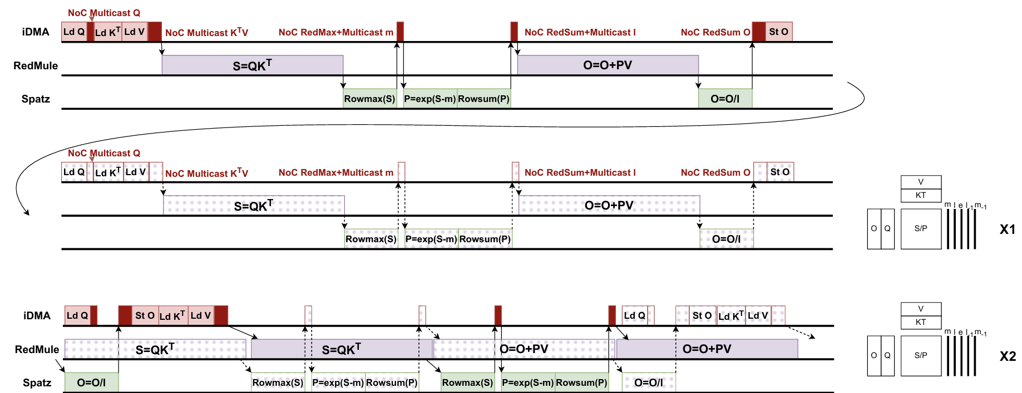
M4-WP1-WP2: Asynchronous FlatAttention
To further improve utilization
Using asynchronization nature of {DMA, Matrix, Vector} engines invoking
One tile group dealing with 2 heads concurrently
Overlap the runtime of {DMA, Matrix, Vector} engines
DMA
Matrix
^{Engine}
Vector
^{Engine}
_{Naïve FlatAttention}
O
Q
V
K^{T}
_{x1}
Att
m l e l₋₁ m₋₁
DMA
_{Asynchronous FlatAttention}
O
Q
V
Matrix
^{Engine}
K^{T}
_{x2}
Vector
^{Engine}
Att
m l e l₋₁ m₋₁

Slide 18
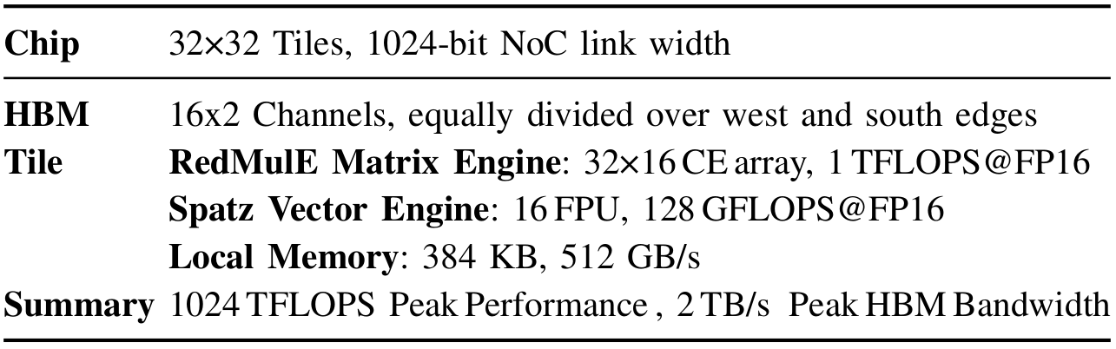
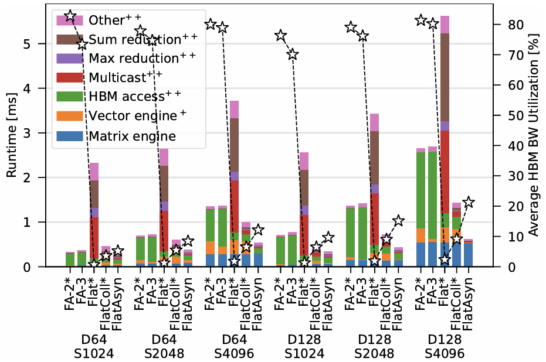
M4-WP1-WP2: FlashAttention vs. FlatAttention
Compare different MHA implementations
FlashAttention-2(FA-2) and FlashAttention-3 (FA-3)
Naïve FlatAttention without (Flat) and with (FlatColl) Collective primitves on NoC fabric.
Asynchronous FlatAttention (FlatAsyn) with NoC collective primitives
With FlatAttention group includes all tiles
Results
FlashAttention is highly memory-bound
FlatAttention significantly reduces HBM access
NoC supported collective primitives are essential to accelerate inter-tile data exchange
With NoC collective primitives + Asynchronous:
Up to 89.3% uti, 4.1× perf speedup, 16× less HBM traffic

Slide 19
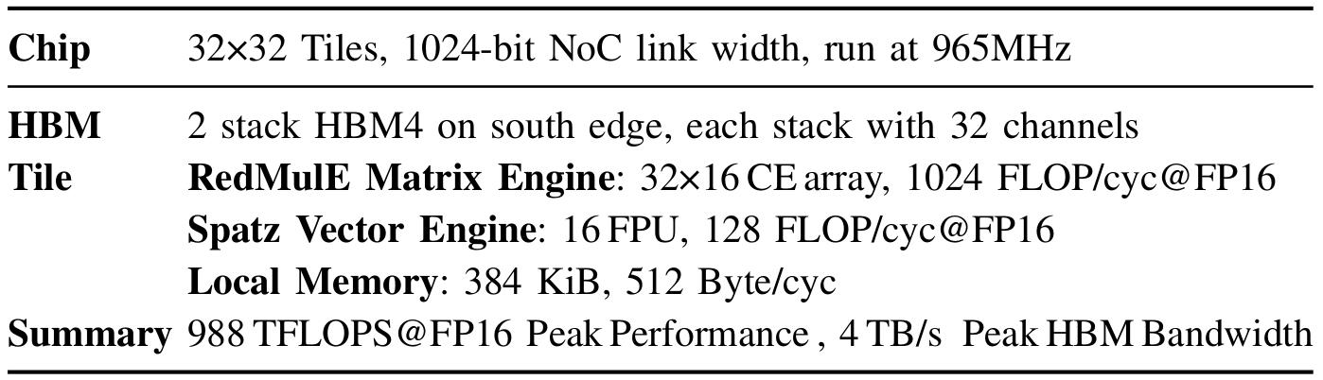
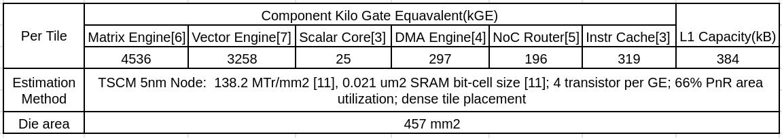
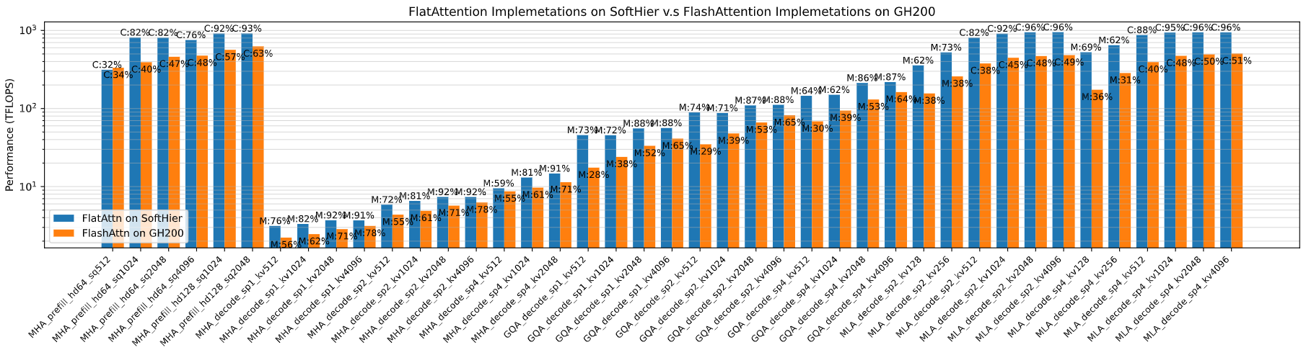
M4-WP1-WP2: FlashAttention on GH200 vs. FlatAttention on SoftHier
Configure SoftHier with the same {FLOPS@FP16, HBM BW} to GH200
Estimate die area cost from reference RTLs
1.8x die size reduction to GH200 (TSMC 5nm)
Generalize FlatAttention to variants like GQA & MLA
C: compute-bound and uti; M: memory-bound and BW uti
Avg {C: 86%,M:78%}, Avg 1.9x speedup to solution on GH200
Prefill MHA
Decode MHA
Decode GQA
Decode MLA

Slide 20
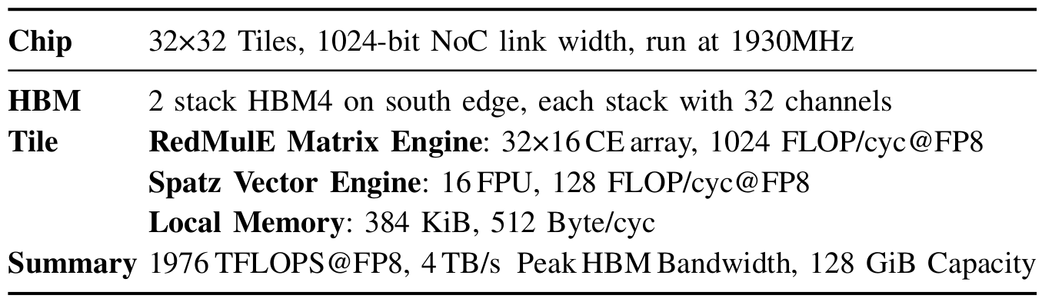
M4-WP1-WP2: Full DeepSeek-671B Decoding on SoftHier
Workload
Full DeepSeekv3-671B
FP8 Decoding with Multi Token Prediction (MTP) enabled
Chip Spec
Configure SoftHier with the same {FLOPS@FP8, HBM BW} to GH200
System Spec
64-Chip system to store 671B parameters
Chip2Chip Interconnect in a 2D Mesh topology
Chip2Chip Link
256ns latency
1TB/s bandwidth
HBM4
HBM4
Chip
C2C Router
C2C Link
Lat = 256ns
BW = 1TB/s

Slide 21
M4-WP1-WP2: Full DeepSeek-671B Decoding Parallelism Scheme
Pipeline Parallelism (PP)
Each Chip decode for one layer
C2C communicate only inter-layer tokens
Full Expert Parallelism (EP64)
Each chip decode for all layers, except for MoE routed experts
Routed experts are distributed over all chips
C2C communication deals with token dispatch to experts and combine results of experts
Hybrid Parallelism
Eg: EP16-PP4
Layer 0
Layer 1
Layer 2
Layer n
k
SoftHier
Chip 0
SoftHier
Chip 1
SoftHier
Chip 2
SoftHier
Chip n
User/Chip
k
k
k
MLA + Shared Expert + Gate
Dispatch
Routed Expert
Combine
Expert 0
SoftHier
Chip 0
k
SoftHier
Chip 0
SoftHier
Chip 0
SoftHier
Chip 0
Expert 1
k
User/Chip
Expert 2
k
Expert 3
k
Expert 4
SoftHier
Chip 1
k
SoftHier
Chip 1
SoftHier
Chip 1
SoftHier
Chip 1
Expert 5
k
User/Chip
Expert 6
k
Expert 7
k
C2C Interconnect
Expert 8
SoftHier
Chip 2
k
SoftHier
Chip 2
SoftHier
Chip 2
SoftHier
Chip 2
Expert 9
k
User/Chip
Expert 10
k
Expert 11
k
……
……
……
……
Expert 252
SoftHier
Chip 63
k
SoftHier
Chip 63
SoftHier
Chip 63
SoftHier
Chip 63
Expert 253
k
User/Chip
Expert 254
k
Expert 255
k
Time
C
C
C
C
C
C
C
C
C
C
C
C
C
C
C
C
C
C
C
C
PP
C
C
C
C
PP
C
C
C
C
PP
C
C
C
C
C
EP
EP
EP
EP
C
C
C
C
C
C
C
C
C
C
C
C
C
C
C
C
C
C
C
C
C
C
C
C
C
C
C
C
C
C
C

Slide 22
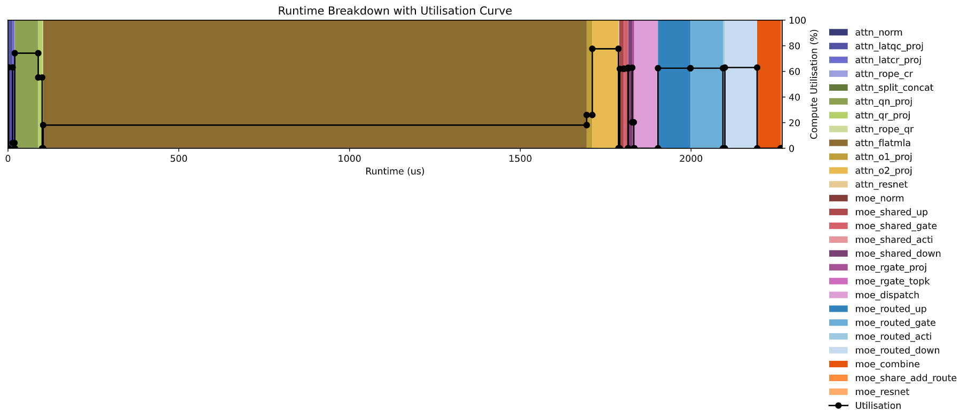
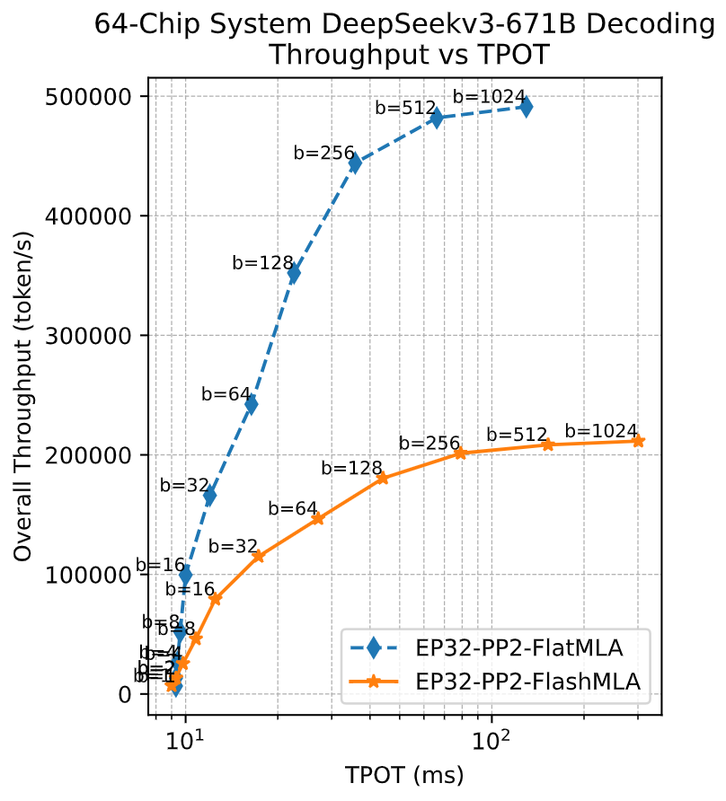
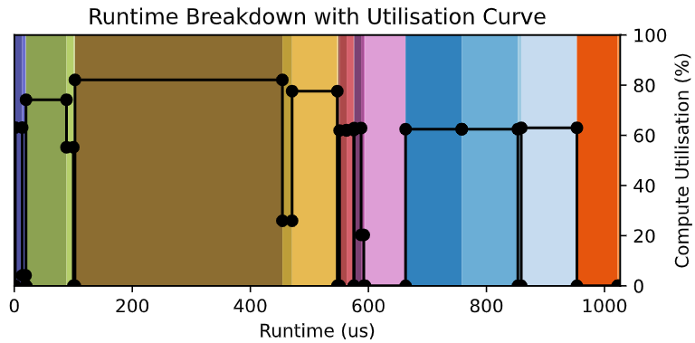

M4-WP1-WP2: Flat vs Flash for DeepSeek-671B Decoding
Benchmark E2E decoding performance on SoftHier Chip Systems @EP32-PP2
Varying users per chip (b), plot the throughput of 64-Chip system vs. time per output token (TPOT) each user
Compare: MLA implemented with proposed FlatAttention (FlatMLA) dataflow v.s using FlashMLA dataflow
@user/chip=256: FlatMLA speedup MLA 4.5x on SoftHier, resulting an E2E speedup of 2.1x
If compared to FlashMLA on GH200 : FlatMLA on SoftHier has 2.2x speedup, and E2E speedup of 1.4x (assuming other kernels runtime are the same)
Better
FlatMLA
E2E Decode Speedup 2.1x
4.5x
FlashMLA

Slide 23
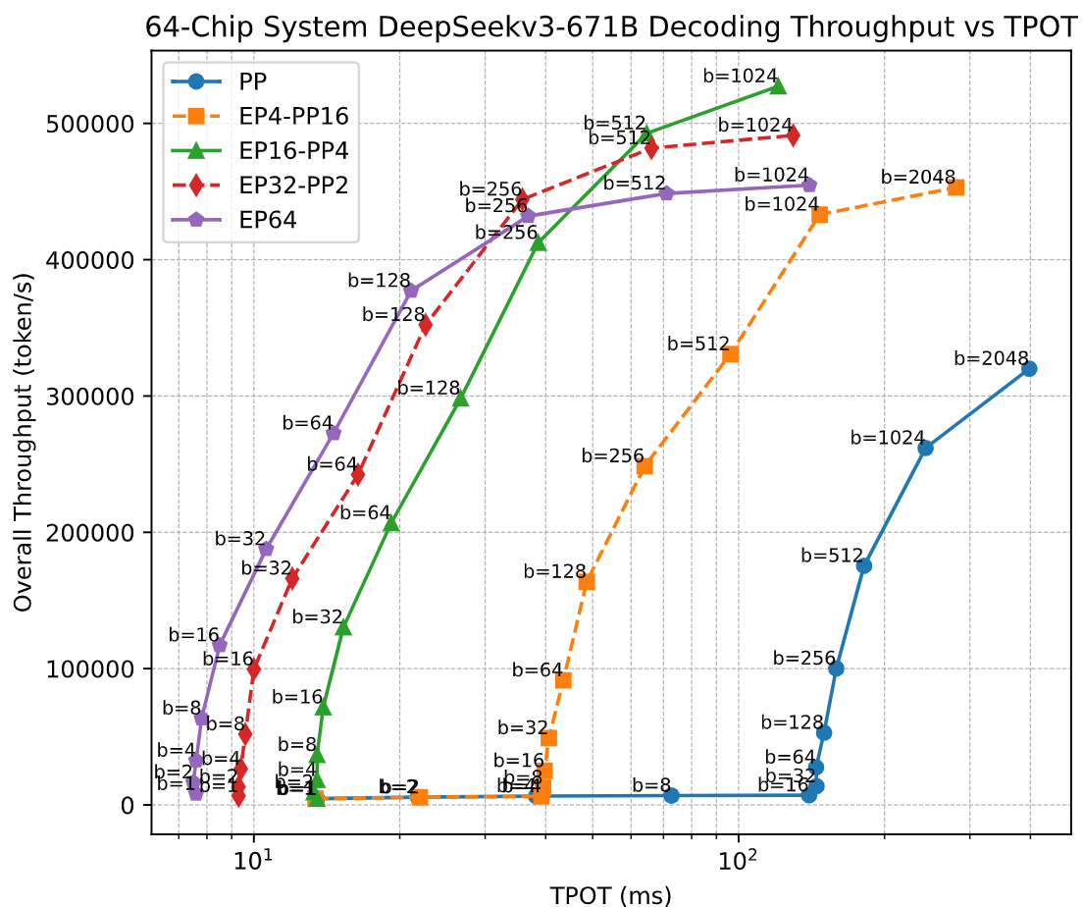
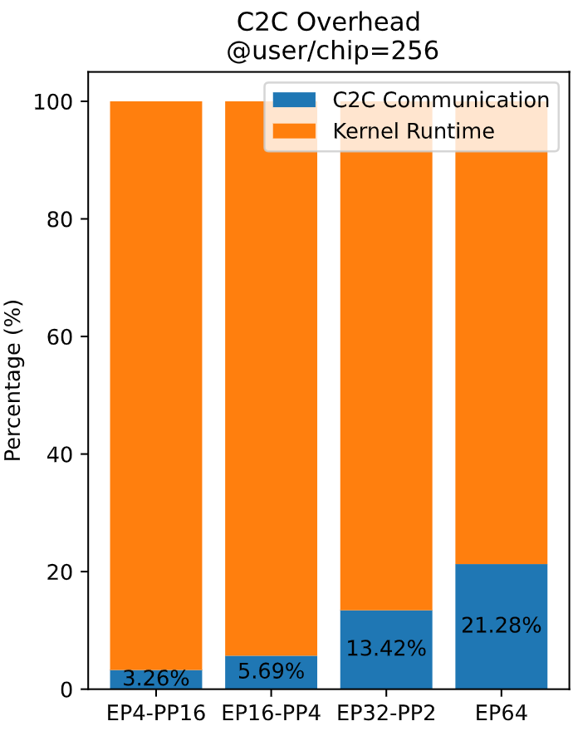
M4-WP1-WP2: Expert Parallelism Trade-off
Effects of Expert Parallelism Scale
Target time per output token (TPOT) for each user: <50ms
Lager EP → Optimize TPOT and Throughput
Lager EP → C2C Communication overhead increase → Decrease throughput at TPOT constraint
Better

Slide 24
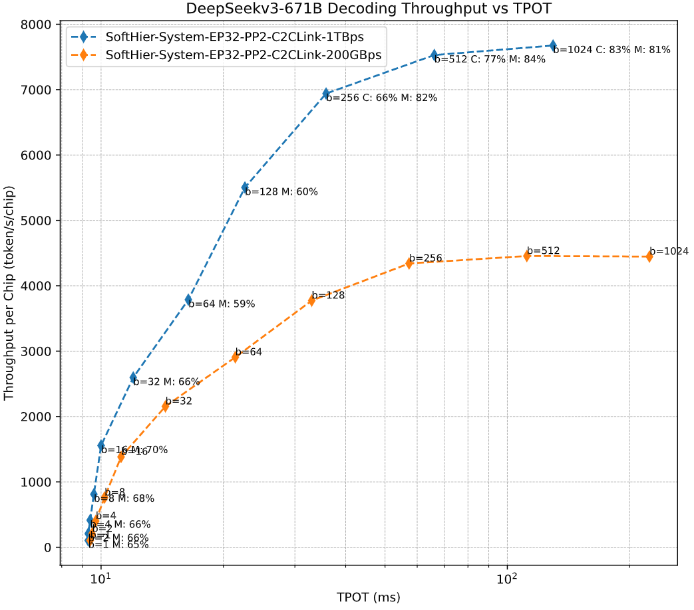
M4-WP1-WP2: SoA Comparison
Comparing to SoA DeepSeek Decoding
SoftHier System uses the EP32-PP2 configuration
Varies the C2C link bandwidth
Normalized to throughput per chip
Compare to SoA: Under 50ms TPOT constraint:
SoftHier C2C link BW = 1TB/s
2.9x speedup to DeepSeek profile^{[3]} on H800
3.6x speedup to CloudMatrix-Infer^{[4]}
SoftHier C2C link BW = 200GB/s
1.6x speedup to DeepSeek profile on H800
1.9x speedup to CloudMatrix-Infer
Better
DeepSeek Profile on H800
CloudMatrix-Infer
Best Throughput
CloudMatrix-Infer
Best TPOT
System | Number of Chips | Chip Interconnect Method | HBM BW per Chip | HBM capacity per Chip | TFLOPS per Chip | User/Chip | KV Cache Length | Throughput per Chip (token/s/chip) | TPOT (ms)
CloudMatrix-Infer on Acsend 910C | 384 | Multi-Plane (UB: 382 GB/s, RDMA: 400 Gbps, VP: 400 Gbps per Chip) | 3.2 TB/s | 128GB | 1504@INT8 | 128 | 4096 | 1943 | 49.4
DeepSeek Profile on H800 | 96 | Multi-Plane (NVLink: 160 GB/s, RDMA: 400 Gbps per Chip) | 3.6 TB/s | 80GB | 1979@FP8 | 128 | 4096 | 2325 | 50.2
SoftHier System Solution | 64 | 8x8 2DMesh: 1TB/s per Chip | 4.0 TB/s | 128GB | 1979@FP8 | 256 | 4096 | 6940 | 35.8
SoftHier System Solution | 64 | 8x8 2DMesh: 200 GB/s per Chip | 4.0 TB/s | 128GB | 1979@FP8 | 128 | 4096 | 3773 | 33.1

Slide 25
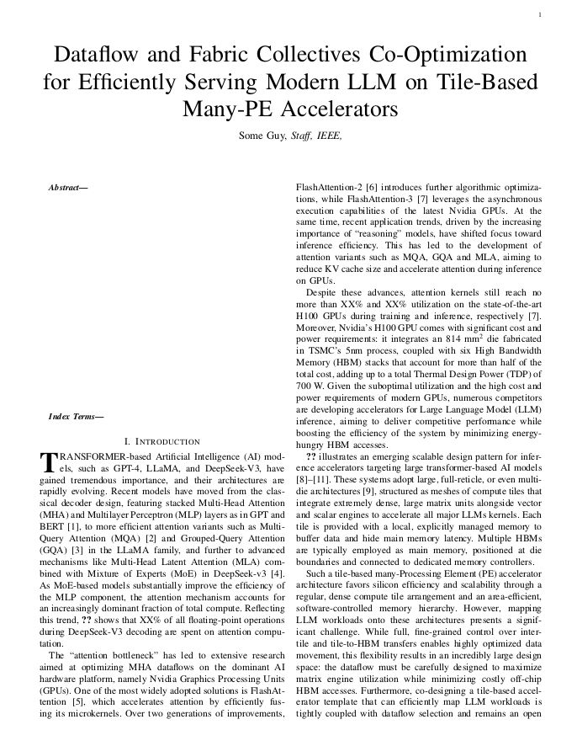
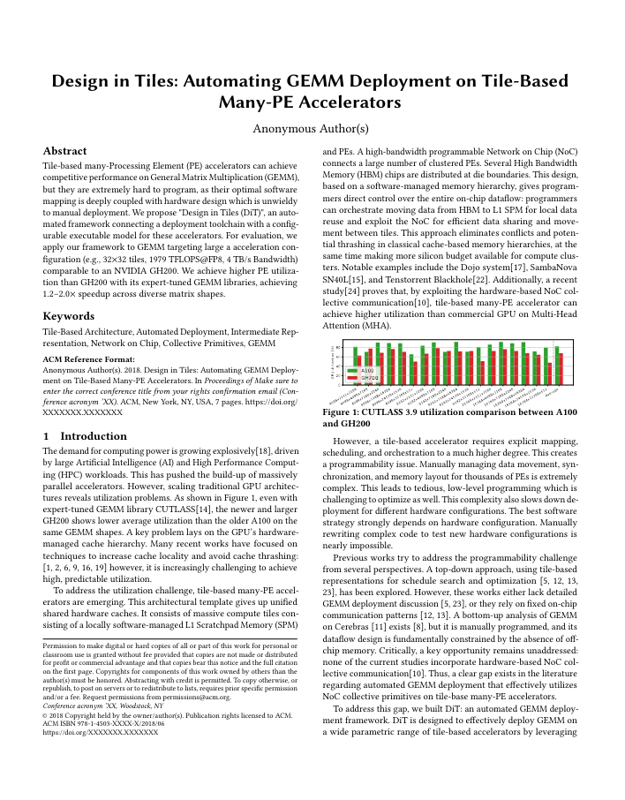
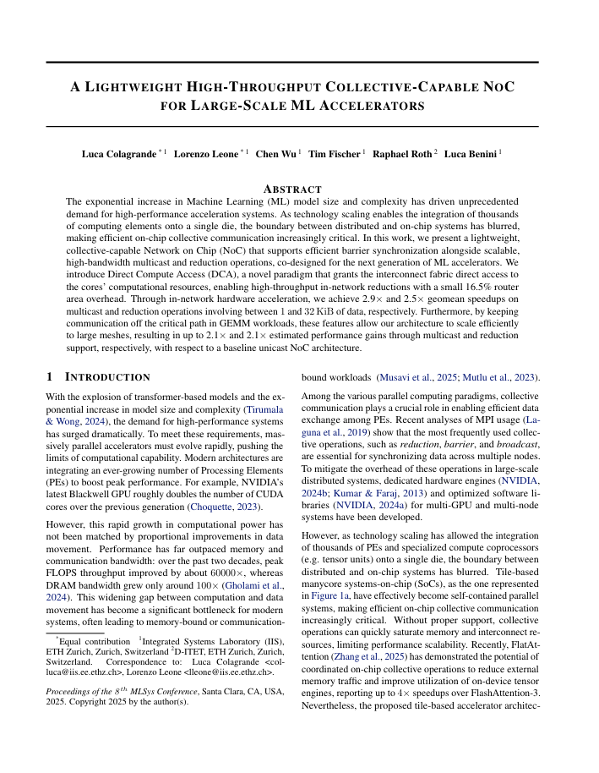
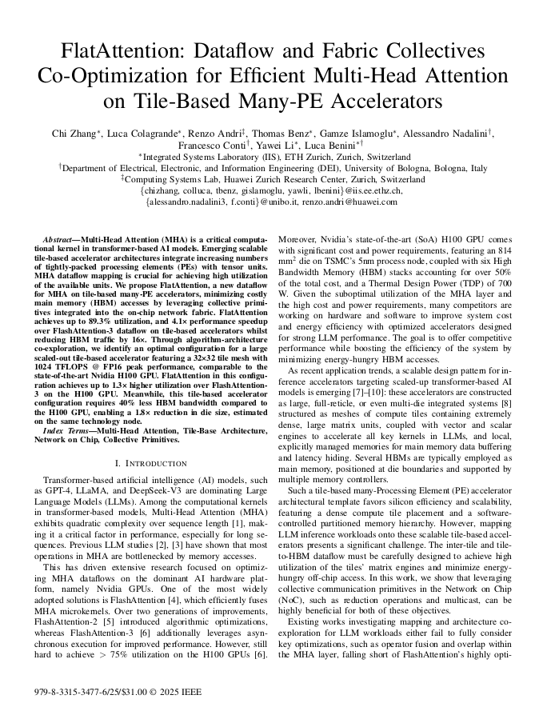
SoftHier Project Conclusion – PULP Team Side
The objective of SoftHier is to drastically reduce hardware inefficiency by replacing caches with software-managed, efficient SPMs and DMAs, while maintaining programming effort low for the application developer
For better HW efficiency we proposed
Lightweight high-throughput collective capable NoC
Dataflow and NoC collective primitives co-design for key LLM kernels
We achieved
Area Efficiency: 1.8x die size reduction to GH200 @same {FLOP, HBM BW}
Energy Efficiency: 16× HBM traffic reduction on the key Attention Kernel
Performance: up to 3.2x speedup in attention kernel vs. solution on GH200, and 2.9x speedup in DeepSeekv3 decoding over SoA solution.
To submit
Submitted: DAC 2026
Submitted: MLSys 2026
Published: ISVLSI 2025

Slide 27
References
[1] N. Bruschi et al., “GVSoC: a highly configurable, fast and accurate full-platform simulator for RISC-V based IoT processors,” in ICCD, 2021.
[2] A. Ivanov et al., “Data movement is all you need: A case study on optimizing transformers,” in MLSys, 2021.
[3] J. Shah et al., “FlashAttention-3: Fast and accurate attention with asynchrony and low-precision,” in NeurIPS, 2024.
[4] Chenggang Zhao et al. “DeepGEMM: clean and efficient FP8 GEMM kernels with fine-grained scaling”. https://github.com/deepseek-ai/DeepGEMM, 2025.
[5] DeepSeek-AI. 2025. Profiling Data in DeepSeek Infra. https://github.com/deepseek-ai/profile-data. Accessed: 2025-05-21.
[6] Zuo, Pengfei, et al. "Serving Large Language Models on Huawei CloudMatrix384." arXiv preprint arXiv:2506.12708. 2025.

Slide 28
Kernels Update: HBM Direction Agnostic
C
Cluster load from HBM and multicast
C
Cluster receive multicast
For FlatAttn, FlatMLA, GEMM
load from HBM & Multicast, reduction
We can fairly discuss different HBM locations without change much kernel code
load from HBM and multicast
multicast
Previous Scheme
Current Scheme
C
C
C
C
C
C
C
C
C
C
C
C
C
C
C
C
C
C
C
C
C
C
C
C
C
C
C
C
C
C
C
C
C
C
C
C
C
C
C
C
C
C
C
C
C
C
C
C
West HBM
C
C
C
C
C
C
C
C
C
C
C
C
C
C
C
C
C
C
C
C
C
C
C
C
C
C
C
C
C
C
C
C
C
C
C
C
C
C
C
C
C
C
C
C
C
C
C
C
C
C
C
C
C
C
C
C
C
C
C
C
C
C
C
C
C
C
C
C
C
C
C
C
C
C
C
C
C
C
C
C
C
C
C
C
C
C
C
C
C
C
C
C
C
C
C
C
C
C
C
C
C
C
C
C
C
C
C
C
C
C
C
C
C
C
C
C
C
C
C
C
C
C
C
C
C
C
C
C
C
C
C
C
C
C
C
C
C
C
C
C
C
C
C
C
South HBM
HBM
SoftHier chip
HBM
SoftHier chip
HBM
SoftHier chip
HBM
HBM

Slide 29
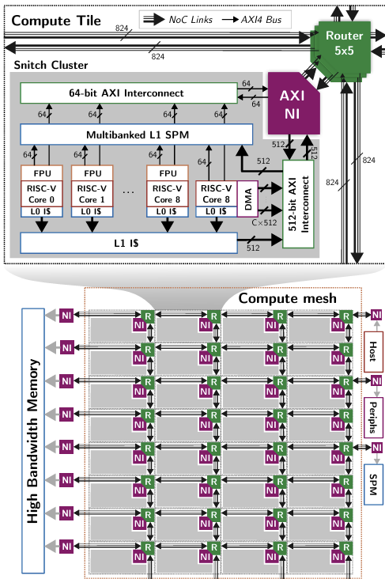
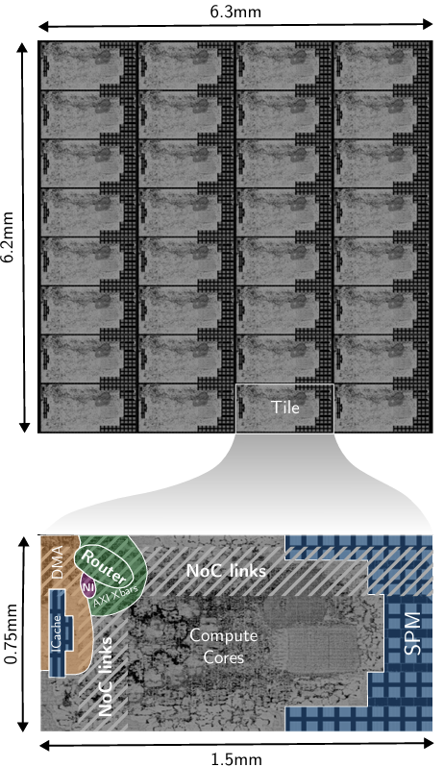
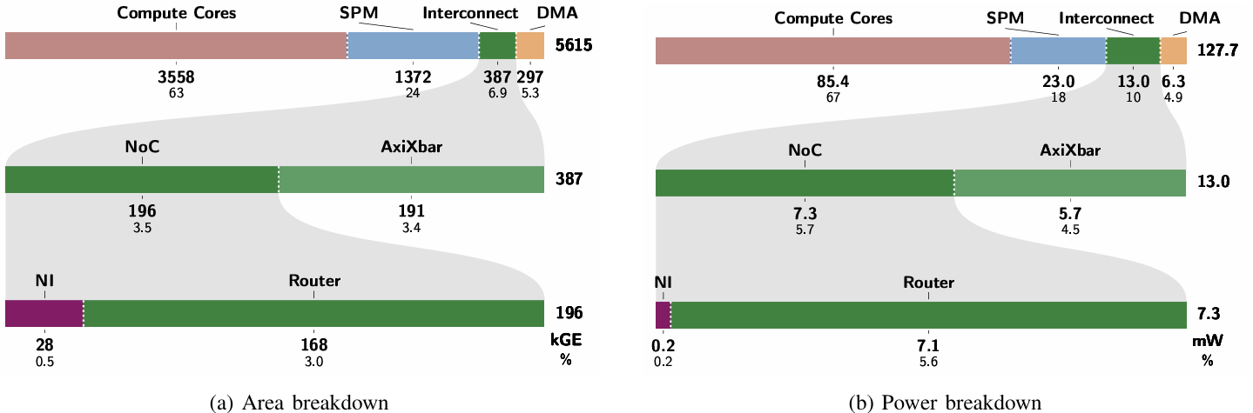
M2-WP1: PPA Estimation
Initial Synthesis and PnR Trial
Thanks to Tim's and Thomas's work on a reduced RTL version of the SoftHier system
RedMule is not included, focusing on the area and power of iDMA and NoC
Synthesis and PnR in GLOBALFOUNDRIES’ 12nm FinFET technology, at the typical corner (0.8V, 25°C)
NoC router with narrow 64b + wide 512b link data width
Timing: SoC frequency of 1.14 GHz reached
iDMA per cluster
Area: 297 kGE (5.3%), Power: 6.3 mW (4.9%)
NoC router per cluster
Area: 196 kGE (3.5%), Power: 7.3 mW (5.7%)

Slide 30
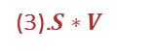
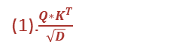
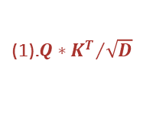
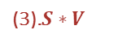
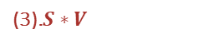
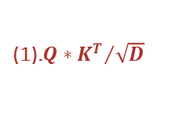
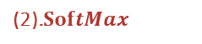

(a)
Output Embeddings
DeepSeek-V3
(b)
Prefill
(c)
Decode
MLP
MoE
D
KV.Len
K^{T}
Input
S
D
K^{T} cached
+
FFN Output
FFN Output
Q
Attention Score
(1).${Q∗K^{T}}/{\sqrt{D}}$
Output
1
V cached
FFN
activation
×
(1).$\frac{Q∗K^{T}}{\sqrt{D}}$
Q
(2)SoftMax
activation
×
E
E
E
E
E
UP
Gate
UP
Gate
routed
S
O
(3).$S∗V$
×H
projection
shared
Router
projection
Input
(d)
D
Normalization
FFN Input
FFN Input
K^{T} cached
(1).${Q∗K^{T}}/{\sqrt{D}}$
(2).$SoftMax$
SP
Q
V cached
+
Attn Output
O
SoftMax(Att.Score)
V
(2)SoftMax
projection
O
Attention
Attn Output
Attn Output
(3).$S∗V$
×H
projection
projection
Q
K
V
Q
K
V
(e)
Q
K
V
Q
Q
K
V
S
Q
K
V
Q
K
V
Q
K
V
D
K^{T} cached
Q
K
V
Q
K
V
RoPE
Up projection
(1).${Q∗K^{T}}/{\sqrt{D}}$
Normalization
Q
K
V
Q
Lat.Q
Lat.KV
GQ
projection
projection
Down projection
Q
V cached
Attn Input
Attn Input
Attn Input
(2)SoftMax
Input Embeddings
×N
(3).$S∗V$
O
MHA
GQA
MLA
×H
(3).$S∗V$
×HG

